Slide 1
Basic principles
Senate and parliamentary procedure overview

Slide 2
What is a Senate?
Yay. Metaphysics….

Slide 3
Senates
Are agents
Do stuff

Slide 4
My idiosyncratic model
The will of a Senate need not correspond to the will of any member.
The will of a Senate is created/discovered through rule-governed debate on motions.
We are engaged in a collaborative process of discovering the will of the Senate.
We are discovering what the senate thinks about ________

Slide 5
What is a Senate?
Terminology
Deliberative assembly
I will use the following basically interchangeably:
Senate
Body or ‘The body’
Assembly

Slide 6
What is a Senate?
Senators comprise senates.
Senators make motions
Senators listen to reports
Senators debate
Senators vote

Slide 7
What is a Senate?
What do Senates do?
Hint: Senates are capable of exactly 1 type of activity

Slide 8
What is a Senate?
What do Senates do?
Senates resolve
They express their will via resolutions

Slide 9
What is a Senate?
Technical aside:
Senates supervene on their members.
The will of a Senate does not supervene on the wills of its senators
That is: Senates can will things which no individual senator supports

Slide 10
Weird. So, how does a Senate will stuff?

Slide 11
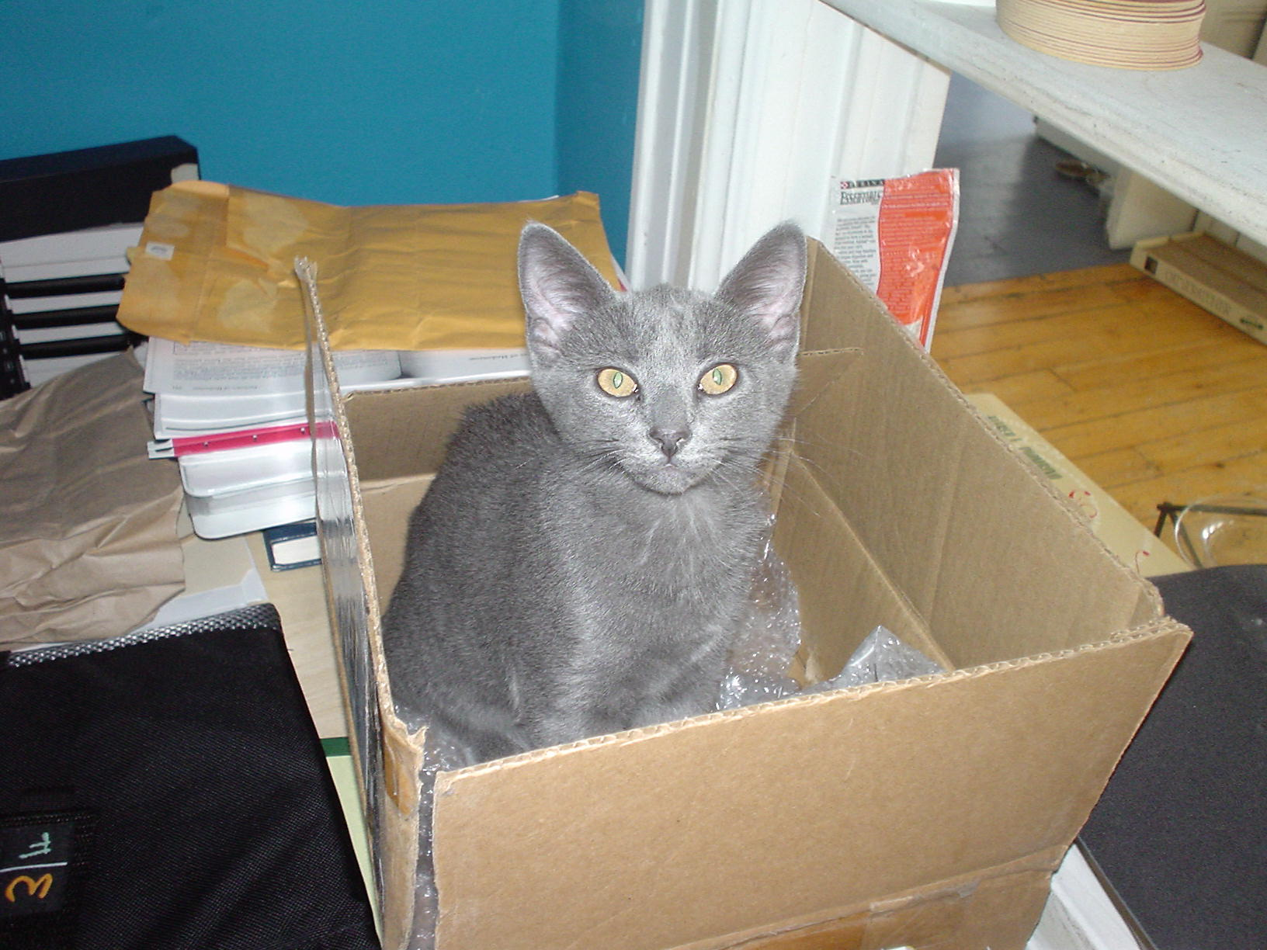
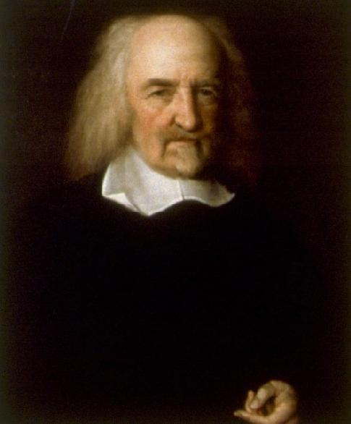
Hobbes

Slide 12
Weird. So, how does a Senate will stuff?
Motions
Back to that in a moment.

Slide 13
Weird. So, how does a Senate will stuff?
That’s not the most helpful question.
Better: How do we discover the Senate’s will?
Or: How does a Senate ensure that its actions are consonant with its members’ divergent interests?
Notes:
Or, if you don’t like reifying the senate into a thing.

Slide 14
Weird. So, how does a Senate will stuff?
That’s not the most helpful question.
Better: How do we discover the Senate’s will?
Or: How does a Senate ensure that its actions are consonant with its members’ divergent interests?
Notes:
Or, if you don’t like reifying the senate into a thing.

Slide 15
Weird. So, how does a Senate will stuff?
How do we discover the Senate’s will?
Answer: Through a formally structured process of deliberation and voting.
Notes:
Or, if you don’t like reifying the senate into a thing.

Slide 16
Weird. So, how does a Senate will stuff?
How do we discover the Senate’s will?
Answer: Through a formally structured process of deliberation and voting.
Parliamentary procedure
Notes:
Or, if you don’t like reifying the senate into a thing.

Slide 17
Sources of procedure (for CSUN)
Constitution
CSUN doesn’t have one of these
Bylaws
Standing Orders
Roberts’ Rules of Order, Newly Revised
NB, this significantly differs from the earlier versions.

Slide 18
Parliamentary procedure’s roles
Two basic goals:
(a) Ensure that the Senate can act.
(b) Ensure that all Senators can contribute equally to the Senate’s actions

Slide 19
Parliamentary procedure’s roles
Two basic goals:
(a) Ensure that the Senate can act.

Slide 20
Parliamentary procedure’s roles
Ensure that the Senate can act.
Divide up issues into manageable chunks
Ultimately, majority rules.

Slide 21
Parliamentary procedure’s roles
(b) Ensure that all Senators can contribute equally to the Senate’s actions
Ensure that those in the minority can:
Express their opinions and attempt to convince others.
Participate in improving resolutions which they oppose.

Slide 22
Parliamentary procedure’s roles
(b) Ensure that all Senators can contribute equally to the Senate’s actions
Ensure that those in the minority can:
Express their opinions and attempt to convince others.
Participate in improving resolutions which they oppose.
Psychosocial work:
Depersonalize debate
Provide a shared framework for dealing with complex problems

Slide 23
(Most) basic principle
The Rules exist so that:
The Senate may act as it pleases
If an application of a rule would render the Senate unable to act, that application is void.
Since procedural motions apply rules, it follows that:
A procedural motion is not in order if its adoption would render the Senate unable to act.
[examples]

Slide 24
Basic principles
1 person; 1 vote
Each Senator gets exactly 1 vote

Slide 25
Basic principles
Each Senator gets exactly 1 vote on any motion they are eligible to vote upon.
i.e., 1 person; 1 vote

Slide 26
No double consideration
Each question may be considered exactly once per session, unless the question is reintroduced through the reconsideration process.

Slide 27
Basic principles
1 person, 1 vote
Only 1 question can be considered at a time.

Slide 28
Only 1 question can be considered at a time
For the programmers in the room: The Body is single-threaded; the motion-tree is a FILO stack, not a tree.

Slide 29
Only 1 question can be considered at a time
Main motion
(The resolution)

Slide 30
Basic principles
1 person, 1 vote
Only 1 question can be considered at a time.
Once a motion is before the body, the question must be disposed of before doing anything else.

Slide 31
Basic principles
1 person, 1 vote
Only 1 question can be considered at a time.
Once a motion is before the body, the question must be disposed of before doing anything else.
Only discussion germane to the pending motion is permitted.

Slide 32
Basic principles
1 person, 1 vote
Only 1 question can be considered at a time.
Once a motion is before the body, the question must be disposed of before doing anything else.
Only discussion germane to the pending motion is permitted.
No discussion without a motion
Move before you speak; do not speak before you move.

Slide 33
In the absence of dissent
The rules are there to help us do things and make decisions.
Where there is no dissent, the rules are not protecting anyone. Thus they may be applied loosely.
As soon as dissent is recognized, the rules are back in force.

Slide 34
Process overview

Slide 35
Step 1: Making motions
Someone makes a motion
‘I move that tacos be provided at Senate meetings’
Someone seconds the motion
‘Second!’
The Chair states the motion
‘It is moved and seconded that tacos be provided at Senate meetings’

Slide 36
Step 2: Consideration
The Senate debates the motion
Subsidiary motions are introduced and disposed of by the same process

Slide 37
Step 3: Decision
The Chair puts the question
(i.e., we vote on the motion)
The Chair announces the result

Slide 38
Preambles/Rationales
Preamble/rationale = ‘whereas’ clauses
Procedure
No amendments are in order on preamble until rationale complete
If Previous Question is ordered before preamble has being considered, it does not apply to the preamble unless explicitly stated.

Slide 39
Consensus
Neither required nor always desirable

Slide 40
Alternative ways of proceeding

Slide 41
Seriatim (Consideration by paragraph)
RONR p.278; section 28

